Slide 1
DEEP belief networks
- Rajat toshniwal (1931013)

Slide 2
INTRODUCTION
Deep Belief Networks are a graphical representation which are essentially generative in nature i.e. it produces all possible values which can be generated for the case at hand.
It is an amalgamation of probability and statistics with machine learning and neural networks.
Deep Belief Networks consist of multiple layers with values, wherein there is a relation between the layers but not the values. The main aim is to help the system classify the data into different categories.
Deep Belief Networks helped to create unbiased values to be stored in leaf nodes.

Slide 3
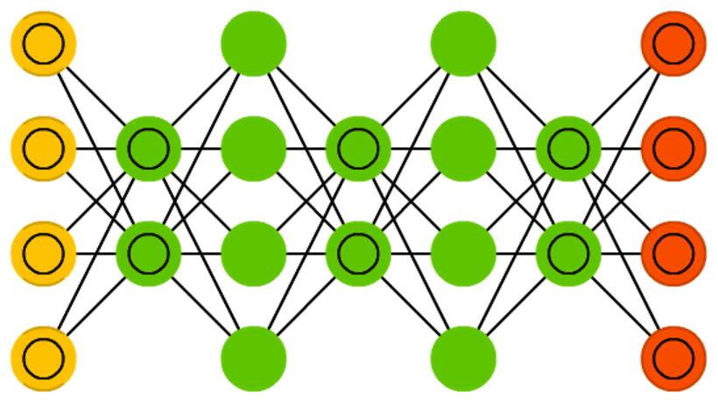
EXPLANATION
DBN’s are composition of simple and unsupervised networks.
DBN’s biggest advantage is it’s capability of learning features, which is achieved by a ‘layer-by-layer’ learning.
In machine learning, a deep belief network (DBN) is a generative graphical model, or alternatively a class of deep neural network, composed of multiple layers of latent variables ("hidden units"), with connections between the layers but not between units within each layer.

Slide 4
USES & ADVANTAGES
Deep-belief networks are used to recognize, cluster and generate images, video sequences and motion-capture data.
A continuous deep-belief network is simply an extension of a deep-belief network that accepts a continuum of decimals, rather than binary data.
For the same level of accuracy, deeper networks can be much more efficient in terms of computation and number of parameters.
Deeper networks are able to create deep representations, at every layer, the network learns a new, more abstract representation of the input.

Slide 5
CONCLUSION
Deep belief networks demonstrated that deep architectures can be successful, by outperforming kernelized support vector machines on the MNIST (Modified National Institute of Standards and Technology is a large database of handwritten digits that is commonly used for training various image processing systems) dataset
Today, deep belief networks have mostly fallen out of favor and are rarely used, even compared to other unsupervised or generative learning algorithms, but they are still deservedly recognized for their important role in deep learning history.

Slide 6
THANK YOU

